Slide 1
Welcome: CS-101 Advanced Information, Computation, Communication
Karl Aberer
Distributed Information Systems Laboratory

Slide 2
In the age of COVID
Everything is different
We will be working largely online
Everything might evolve and change throughout the semester
Program of today:
Hour 1: Everything you need to know on the organization
Hour 2: A teaser on the contents of the class

Slide 3
Textbook
This class will be following closely the book "Discrete Mathematics and Its Applications" by Kenneth H. Rosen, published by McGraw-Hill

Slide 4
Online Platforms
Moodle
You should be registered and you should have been there
You find all the links and details in the accouncements
Zoom
Since you are here you know it
Switchtube
For registered lecture and pre-registered course content
Discord
For exercises and interacting with your assistants

Slide 5
Questions
I have been visiting Moodle: yes/no
I found the information sheet for the course: yes/no
I have been already using Discord: yes/no
I have a suitable working environment at home: yes/no
I am on campus today: yes/no

Slide 6
Weekly Schedule
Every week is dedicated to a Topic
We will proceed in the following steps:
Friday afternoon, 16:00 – 18:00: self-study
Pre-registered videos, chapters for reading, slides, exercises
Switchtube, Moodle, Discord
Tuesday morning, 8:00 – 10:00: online session
Content summary, quizzes, question-answer, elaborate examples and proofs
Zoom, Switchtube (registered session)
Friday morning, 10:00 – 12:00: exercise
Exercises, interaction with assistants, on-campus
Discord

Slide 7
Exercises
Every student will be assigned an exercise team with a head assistants
We have 24 teams, arranged into the A,B,C group students
The teams that are on campus can meet in the assigned class rooms
INJ218 (96 - 2 groups), INM10 (62 -1 group), INM11 (42 - 1 group),
INM200 (79 - 1 group), INM202 (86 - 2 groups), INR219 (79 -1 group)
Detailed schedule will be communicated when we have student data!

Slide 8
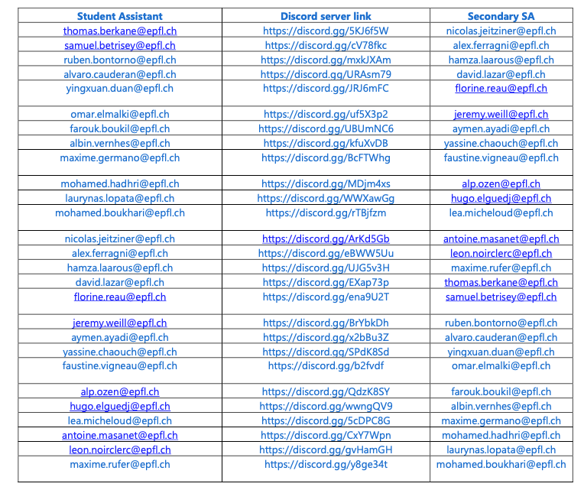
Student Teams on Discord

Slide 9
Attendance
Attending the online lectures or participating in the exercise sessions is not mandatory, but strongly recommended.
It is also recommended to actively participate through questions!

Slide 10
Asking Questions
You have 4 channels to ask questions
Platform | modality | when | answered | visibility
Moodle | offline | After studying | Tuesday session | public
Zoom chat | online | During online class | Tuesday session | public
Discord | offline | During the week | Friday exercise | Public or private
Discord | online | During Friday exercise | Friday exercise | Public or private

Slide 11
Topics of the Course
Week 1 | Propositional Logic
Week 2 | Predicate Logic
Week 3 | Proofs
Week 4 | Sets, Functions, Relations
Week 5 | Relations, Sequences, Summations
Week 6 | Algorithms
Week 7 | Complexity of Algorithms
Week 8 | Number Theory
Week 9 | Induction and Recursion
Week 10 | Counting
Week 11 | Advanced Counting
Week 12 | Probability
Week 13 | Advanced Probability

Slide 12
Exam
There will be one exam (the final exam)
There will not be a midterm exam
The final exam will be in both French and English.
It will consist of 24 multiple choice questions on subjects treated during the semester.
Per multiple choice question precisely one of the four answers is correct.
Representative example questions will be made available.

Slide 13
Grading
The grade is calculated based on the number of questions for which only the correct answer is ticked.
There is no penalty for incorrectly answering a question (i.e., ticking a wrong answer, or ticking multiple answers)
so on average guessing is more advantageous than not answering a question at all (i.e., not ticking any of the four answers).

Slide 14
Conditions
Absence
You have to submit a doctor’s attest if you miss the final exam due to sickness.
No other reasons for not taking the final exam will be accepted.
Irregular behaviour
In case of irregular behaviour during the final exam EPFL’s standard policies apply.

Slide 15
Contacts
Lecturer: Karl Aberer, karl.aberer@epfl.ch
You can contact me anytime by email.
If necessary, I will schedule a Zoom meeting to clarify critical questions.
Teaching assistants:
Negar Foroutan, negar.foroutan@epfl.ch
Mohammadreza Banaei, mohammadreza.banaei@epfl.ch
Please contact them for any organisational questions or questions related to the course content that you cannot resolve with your teaching assistant.

Slide 16
Program of this Week
No Friday morning exercise session!
Use the time to make sure that you are familiar with all platforms!
Ask if anything is not clear.
Friday afternoon: You will receive the materials on the first topic:
Propositional logic

Slide 17
Stay tuned!
We might to adapt our organization to the circumstances, experiences and feedbacks received

